Slide 1
Disclaimer
All the topics followed in this lecture are from Engineering Economy by R. Panneerselvam 4th Edition, which is being used as a standard textbook for this course. The data taken from the book is entirely for study purposes and no copyright infringement is intended.

Slide 2
Chapter 8 Part 1
Replacement and Maintenance Analysis

Slide 3
Types of maintenance
Types of Replacement problem

Slide 4
Reasons for considering the replacement
There are two basic reasons for considering the replacement of an equipment
Physical impairment of the various parts or
Obsolescence of the equipment.

Slide 5
Physical impairment refers only to changes in the physical condition of the machine itself. This would lead to a decline in the value of the service rendered, increased operating cost, increased maintenance cost or a combination of these.
Obsolescence is due to improvement of the tools of production, mainly improvement in technology.

Slide 6
Sometimes, the capacity of existing facilities may be inadequate to meet the current demand. Under such situation, the following alternatives will be considered.
Replacement of the existing equipment with a new one.
Augmenting the existing one with an a additional equipment.

Slide 7
TYPES OF MAINTENANCE
Maintenance activity can be classified into two types:
preventive maintenance and
breakdown maintenance.

Slide 8
Breakdown maintenance is when the organization only conducts maintenance on a piece of equipment when the equipment breaks down.
Preventive maintenance is when an organization conducts maintenance activities, including inspections, to help ensure equipment is functioning within their expected parameters and to catch indications of minor issues, so that they can be addressed before a bigger problem occurs. is regularly performed on a piece of equipment to lessen the likelihood of it failing.

Slide 9
Replacement of assets that deteriorate with time (Replacement due to gradual failure, or wear and tear of the components of the machines).
This can be further classified into the following types:
(i) Determination of economic life of an asset.
(ii) Replacement of an existing asset with a new asset.

Slide 10
DETERMINATION OF ECONOMIC LIFE OF AN ASSET
Any asset will have the following cost components:
Capital recovery cost (average first cost), computed from the first cost (purchase price) of the machine.
Average operating and maintenance cost (O & M cost).
Total cost which is the sum of capital recovery cost (average first cost) and average maintenance cost.

Slide 11
EXAMPLE 1
A firm is considering replacement of an equipment, whose first cost is Rs. 4,000 and the scrap value is negligible at the end of any year. Based on experience, it was found that the maintenance cost is zero during the first year and it increases by Rs. 200 every year thereafter.
(a) When should the equipment be replaced if i = 0%?
(b) When should the equipment be replaced if i = 12%?
(a) When i = 0%. In this problem,
(i) First cost = Rs. 4,000
(ii) Maintenance cost is Rs. 0 during the first year and it increases by Rs. 200 every year thereafter.

Slide 12
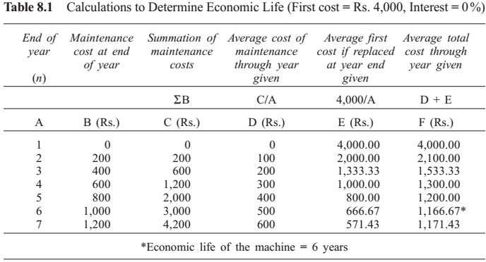

Slide 13
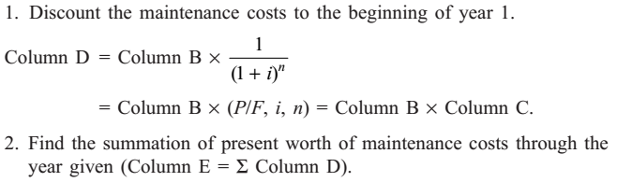
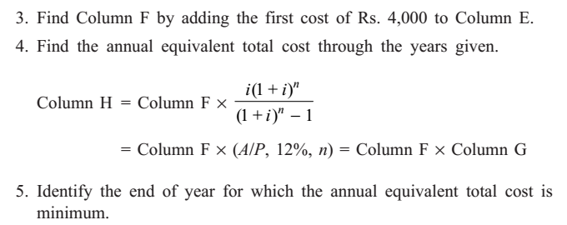
The steps performed for 12 % interest rate :

Slide 14
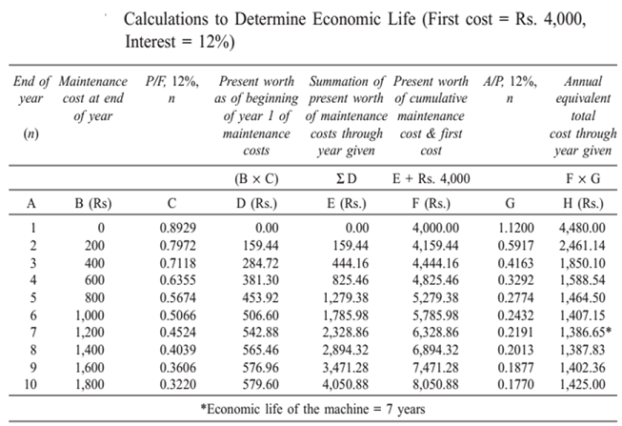



Slide 15
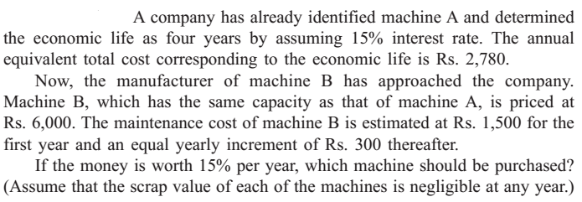
EXAMPLE 2
Determine the economic life and annual equivalent total cost of machine B.

Slide 17
The End

